Slide 1

User Engagement &
Content Performance
Capstone Project Part 1 - Final Presentation
Unlocking Growth with Data-Driven Insights
Presented by: Group 5

Slide 2
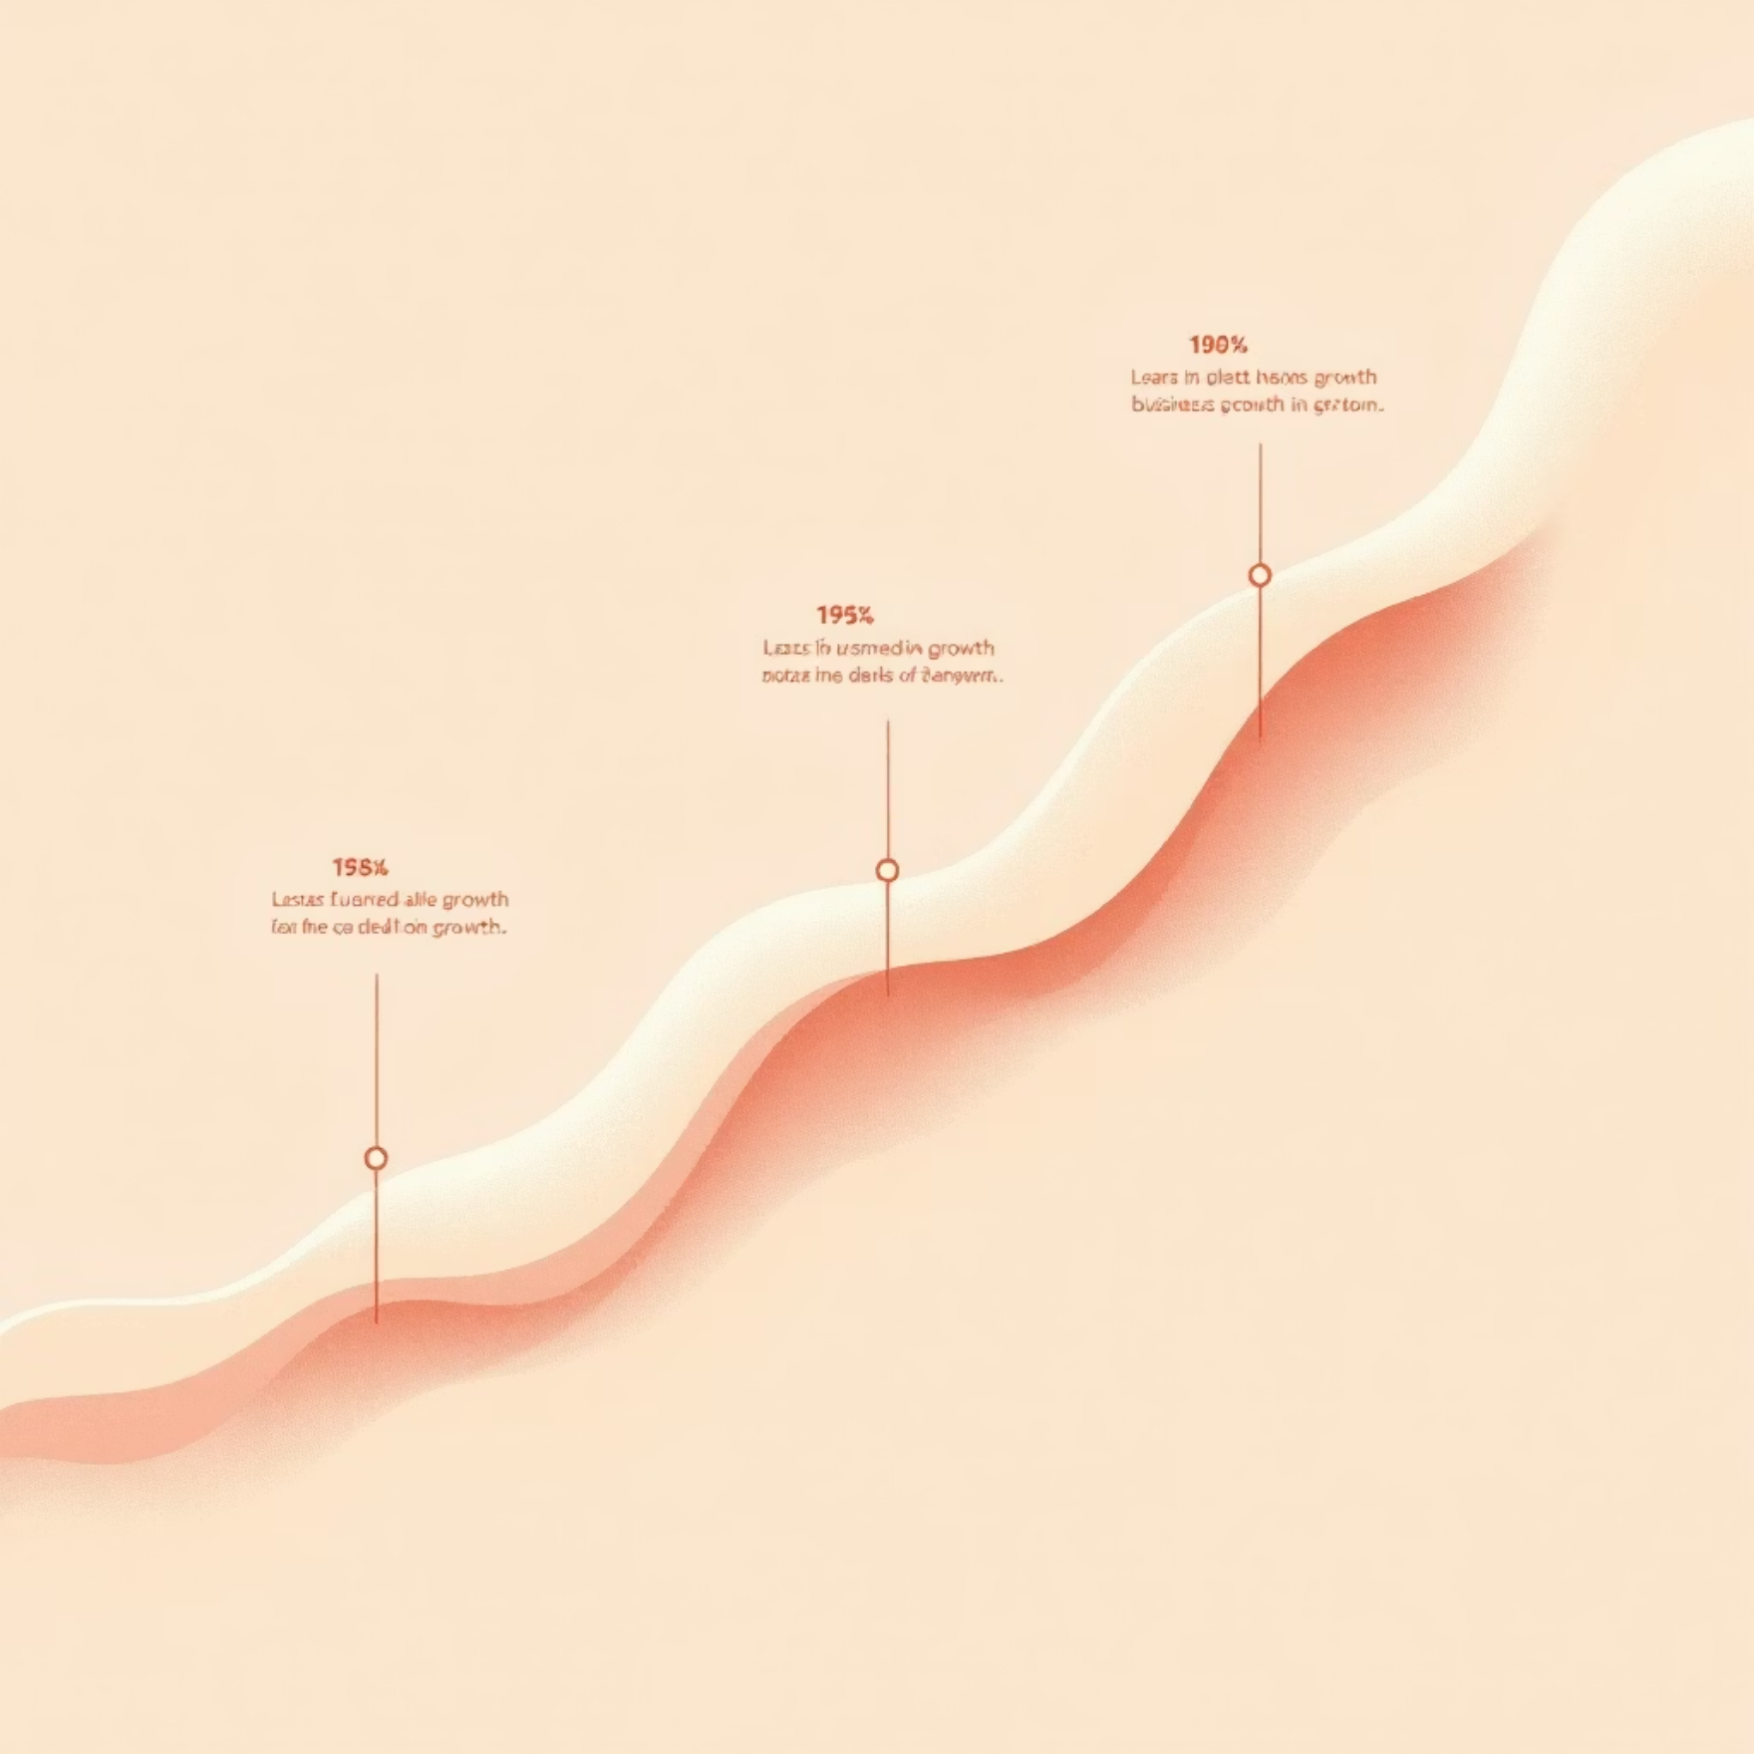

Project Introduction & Objectives
Project Scope
Core Objective
Our analysis delved into 8.5 years of comprehensive user lifecycle data, spanning from 2017 to 2025, to meticulously map out engagement patterns and identify critical touchpoints.
The primary goal is to address the prevalent "Engagement Crisis" by uncovering the root causes of user churn and developing effective strategies to significantly improve retention rates across the platform.
Transforming raw user data into actionable strategies is paramount for increasing platform adoption and sustained user growth.

Slide 3
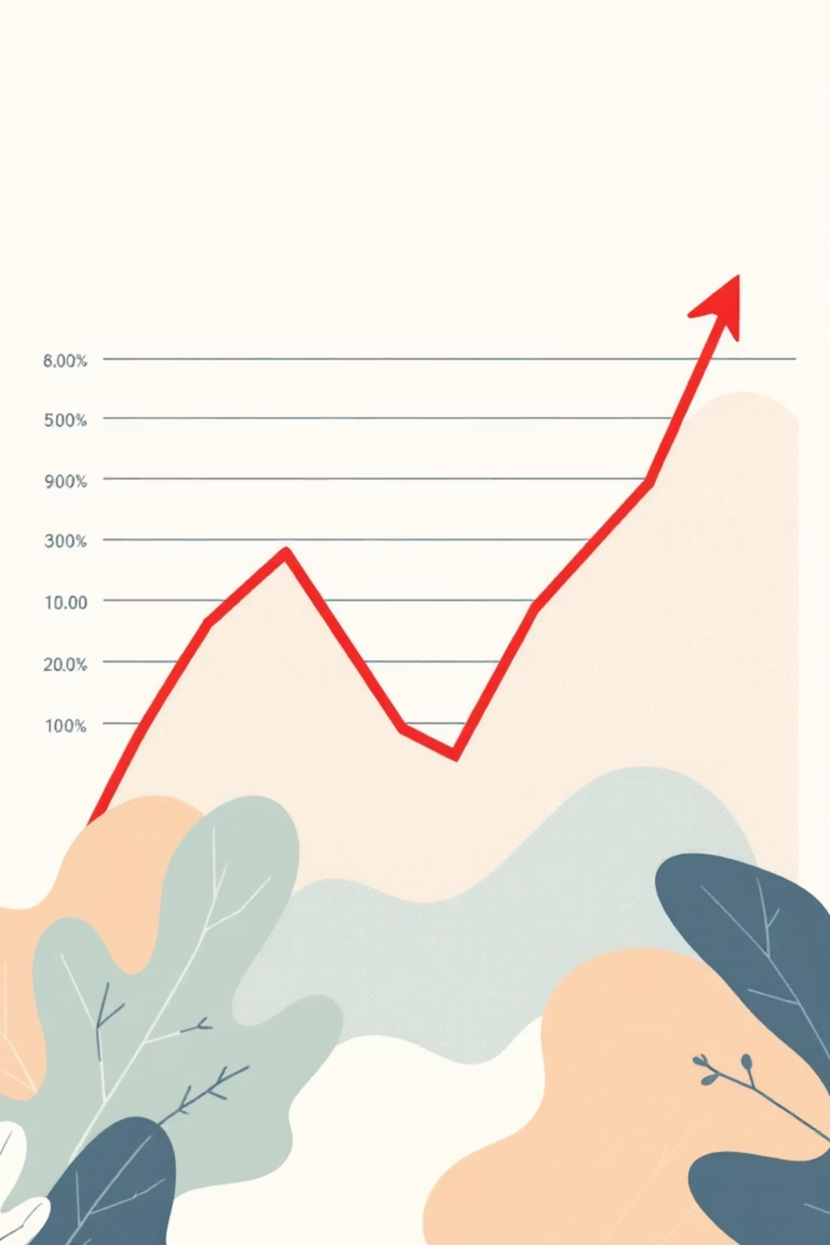
Understanding the Problem: Key Challenges
High User Churn
Gamification Gaps
A significant proportion of users disengage almost immediately following the sign-up process, indicating a critical early-lifecycle issue.
The existing reward mechanisms, such as badges and points, are not effectively incentivising long-term engagement or desired user behavior.
Verification Friction
The current verification process is overly complex, creating a substantial bottleneck that hinders new user onboarding and activation.

Slide 4

Dataset at a Glance
Our analysis was powered by a live Athena connection to Halight’s internal database, ensuring real-time insights into user behavior.
Data Volume
~72,000 Unique Users: This figure was obtained after a rigorous cleaning process that removed over 30,000 duplicate entries.
Key Attributes Tracked
Profile Information: User Type (e.g., Retail Sales), Associated Retailer (e.g., T-Mobile, Allina), and geographical Location data.
Activity Metrics: Detailed records of user Logins, accumulated Points, and their Last Online Date.
Account Status: Categorisation into Active, Deleted, Disabled, and Verified states.

Slide 5




Methodology: From Raw Data to Actionable Insights
Data Cleaning
We systematically removed 12 columns exhibiting >90% missing data and effectively managed null values, for instance, by labeling null dates as "Never Verified" for clarity.
Feature Engineering
New metrics such as "Days Online" and "Account Age" were created to provide a more accurate measure of true user engagement over time.
Analysis
A combination of Univariate Analysis for understanding data distributions and Bivariate Analysis for correlating Verification Status with Retention rates was employed.

Slide 6
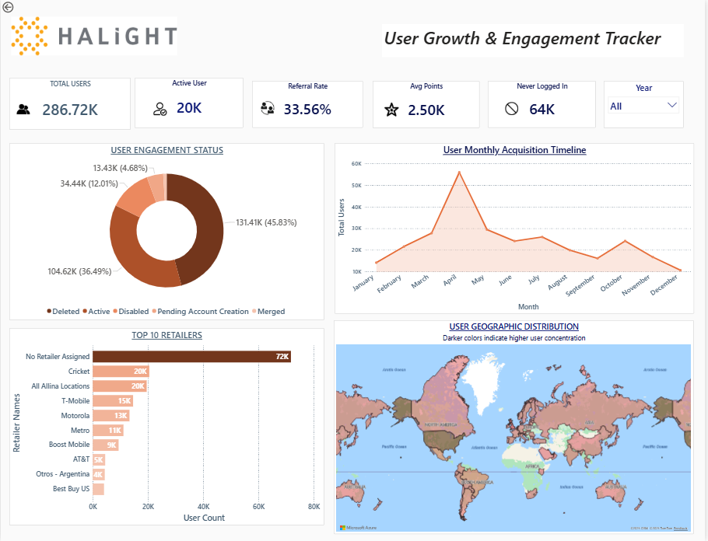
https://app.powerbi.com/groups/me/reports/a93360d1-62c6-4698-bce9-9c1126c1f274/6b8876eaed8060de741e?bookmarkGuid=fc566066-ee94-4551-b7b6-8ba1170b5023&bookmarkUsage=1&ctid=c986676f-9b39-4d08-b4f8-a668e0e8c6a5&portalSessionId=d2fc562f-7502-4295-a590-521da6b654c9&fromEntryPoint=export

Slide 7
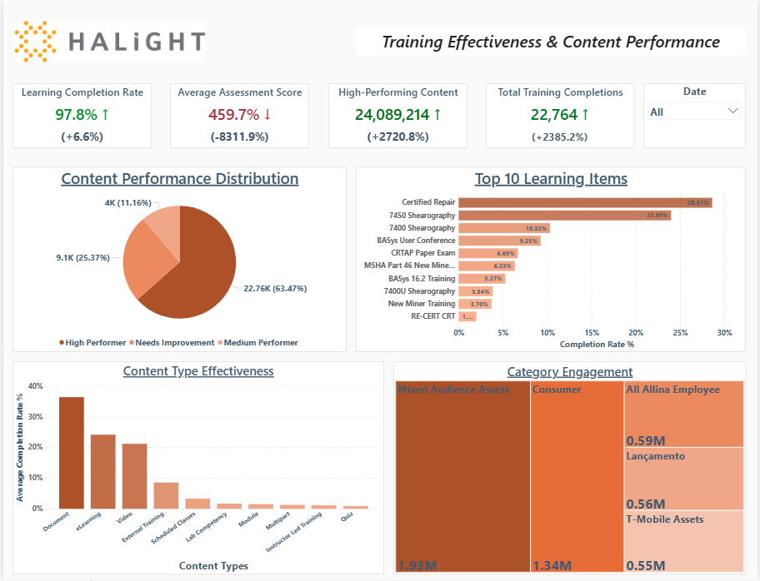

Slide 8

Insight I: The Engagement Drop-off Cliff
The "One-Week" Wall
A striking 75% of users have spent 4 days or less online throughout their entire lifecycle, indicating a significant drop-off
very early on.
Inactive Majority
Over 50% of our user base has recorded zero learning completions, suggesting a fundamental disconnect with the
platform's core offerings.
Mobile Opportunity
Despite prevailing mobile-first trends, 72% of users are not utilising the dedicated app, highlighting a critical need for a "Mobile-First" strategy push.

Slide 9

Insight II: The Verification Paradox
We uncovered a counter-intuitive trend within our user data:
Users classified as "Partially Verified" frequently exhibit higher engagement, with a median of 50+ days online, compared to "Fully Verified" users, who average only around 10 days.
Implication
This suggests that our current verification process might be excessively stringent, inadvertently filtering out eager and potentially highly engaged users before they can fully integrate with the platform.
Strategic Shift Required
It is imperative that we lower the barrier to entry for new users to foster greater initial engagement and ultimately improve retention.

Slide 10
Insight III: Retailer Segmentation & Performance
Our analysis reveals significant disparities in user engagement across different retailer segments, offering valuable lessons for standardisation.
85%
30%
60%
T-Mobile Engagement
Smaller Partners Engagement
Average Engagement
High engagement with consistent login patterns.
Exhibiting high "Sign-up and Leave" rates.
Platform-wide average engagement.
The performance gap between retailers highlights opportunities for sharing best practices.
Onboarding strategies proven successful with top-tier segments, such as T-Mobile, should be rigorously standardised and rolled out across the entire platform to uplift overall engagement.

Slide 11



Future Work & Innovation Roadmap
AI-Driven Dashboard Agent
Predictive Churn Classifier
Dynamic Persona Clustering
Implement a "Chat with Data" AI agent (LLM) for real-time updates and instant answers to queries like "Which region had the highest drop-off yesterday?"
Develop a Machine Learning model to proactively flag "At-Risk" users, enabling interventions before account deletion.
Utilise unsupervised learning (K-Means) to group users by behavioral patterns (e.g., "Weekend Learners") rather than static job titles.

Slide 12


